Slide 1

Facial Demographics
PS Instructor: Prof. Aruna Malapati
Mentor: Mrs. Tanisha Bhayani
Group Members:
1. Shreyansh Joshi (2018A7PS0097G)
2. Ashutosh Sharma (2018B3A70928P)
3. Vikas Sheoran (2018B3A70847H)
4. Jash Shah (2018A8PS0507P)

Slide 2
Seminar 1 summary in 2 mins
Eda on dataset metadata
Add @shreyansh, vikas , jash
Later will add this as speaker’s notes for pre misem outline

Slide 3
Work Done till now…...
Week 1 : Familiarization Deep Learning and Facial demographics by reading 6 research papers provided by ma’am.
Week 2 : Performed EDA on the dataset, to understand data distribution as well as know more about
the given dataset.
Week 3: Basic model for gender and age classifier, that classifies gender and age into 2 and 5 classes respectively.
Notes:
The plan is to first attain a baseline, then in try to optimize the model to achieve better accuracy, using various techniques such as standardizing data, regularizing model, etc.

Slide 4

Contents
Introduction to Facial demographics
Project Outlines
Work Plan
Conclusion and the Way forward
Notes:
So, I will briefly tell you the contents of this presentation. I will start off with introducing the topic and explain the actual meaning of the term. We will then move on to discussing the Project Outlines( slide 4) and our Weekly Goals (Slide 5) and Milestones (Slide 6, 7 and 8) we have achieved. While talking about the Work Plan we would stress a bit on the Technical aspects of the Project by discussing about various models that we are aiming to use. Lastly we would conclude the presentation by talking about the our learning outcomes and importance of this project.
So, beginning with the first first component of our presentation.........

Slide 5

What is Facial Demographics ?
•Facial demographics, essentially refers to taking facial images as input , preprocessing it, and extracting useful information from faces using Machine Learning techniques.
•Analyzing different features of a person from face such as gender, age, race are a part of facial demographics.

Slide 6
Our Project
• At Silver Touch Technologies, the main project is to predict the gender and age of a person given his/her face image.
• This is accomplished using Machine Learning / Deep Learning Techniques such as CNNs.
• Different students were asked to work on different approaches –
1. Designing CNN architecture from scratch – Shreyansh, Ashutosh
2. Transfer Learning with CNNs - Vikas
3. Core ML models such as SVMs - Jash

Slide 7
Weekly Outline (Post Mid-sem)
Week 4 : Continue implementation of age and gender classification, trying to get above the baseline and improve accuracy.
Week 5 : Jump onto age estimation, trying to predict exact ages. Try using another dataset and perform EDA on it as well and then perform age estimation on it.
Week 6: Optimise the model to its best, and benchmark its performance. Finally, design a script (pipeline) , so that it can be deployed as an end-to-end Deep Learning model in real world.
Notes:
The plan is to first attain a baseline, then in try to optimize the model to achieve better accuracy, using various techniques such as standardizing data, regularizing model, etc.

Slide 8
Project Methodology

Slide 9
Literature Review
Research Paper | Author(s)
Age Group and Gender Estimation in the Wild with Deep RoR Architecture | K. Zhang, Ce Gao, Liru Gao, Miao Sun, Xingfang Yuan ,Tony X. Han, Zhenbing Zhao , Baogang Li
Face Recognition Based on CNN | Musab Coskun, Aysegil Ucar, Ozal Yildirim, Yakup Demir
Face Recognition and Age Estimation implications of Changes in Facial Features: A Critical Review Study | Rasha R. Atallah, Amirrudin Kamsin, Maizatul A. Ismail, Sherin A. Abdelrahman, Saber Zerdoumi
Age estimation via face images: A Survey | Raphael Angulu
Convolutional Neural Networks for Age and Gender Classification | Ari Ekmekji
Notes:
We begun by reviewing literature available on the problem. These were the research papers that we went through………..
The research papers talked about varioud Deep Learning stragies and the CNN models.
They also stressed on the real life importance of facial demographics in daily life

Slide 10
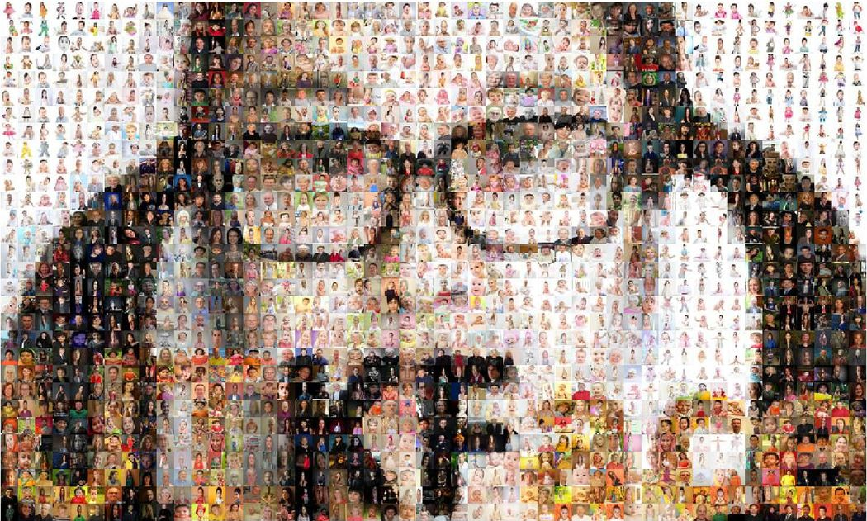
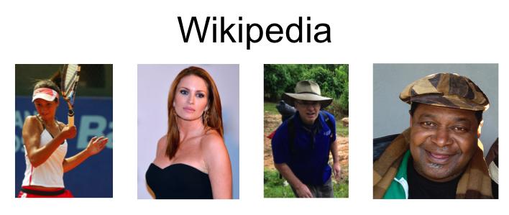
Dataset used:
23,708 Images
Other
Dataset used:
62,308 Images
Notes:
The dataset we are using for training our model is the UTKFace dataset. It is a large-scale face dataset consisting of 20,708 face images. All images are 200x200with annotations of age, gender, and ethnicity. The images cover large variation in pose, facial expression, illumination, occlusion, resolution, etc.

Slide 11

EDA (Exploratory Data Analysis) of Image data
EDA refers to the critical process of analyzing data sets so as to discover patterns, spot anomalies, summarize their main characteristics with the help of summary statistics and graphical/visual methods.
Earlier EDA was performed on metadata, now we did
EDA on the actual image pixel data, as well.
Notes:
Cross-labels mean, variance, histograms, PMFs, IQR, Pie charts, scatter plots, box plots, bee swarm plots, violin plots, count plots, etc. were some of the techniques we used.

Slide 12
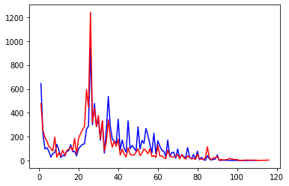
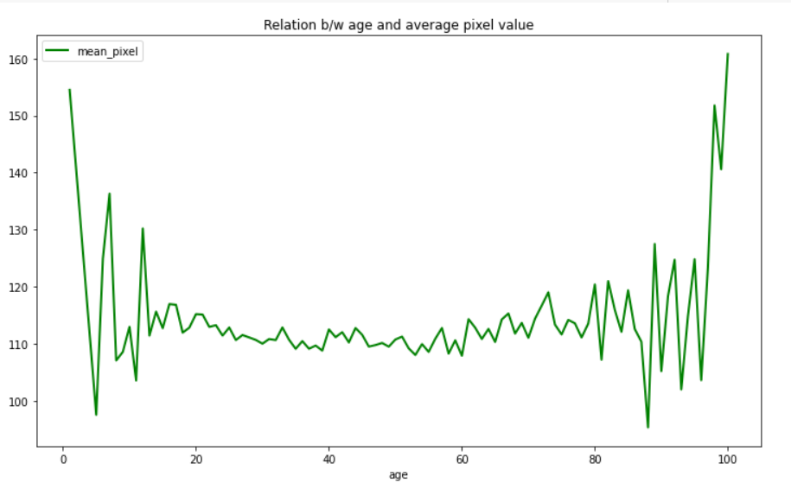
Age vs frequency plot
Some example of the analysis we did…...
Male
Female
Relation between age and average pixel values
Age
Notes:
Relation b/w age and average pixel value (wikipedia dataset)

Slide 13
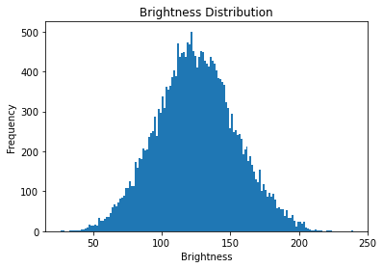
Notes:
Here, we plotted a graph b/w age and avg pixel value of the image.
Interestingly enough, we find that the avg pixel value of middle age (20-80) seem to be variating over a small range whereas avg mixel values of both higher and lower ages vary much)

Slide 14
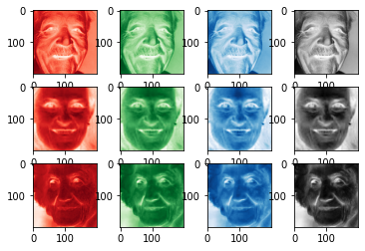
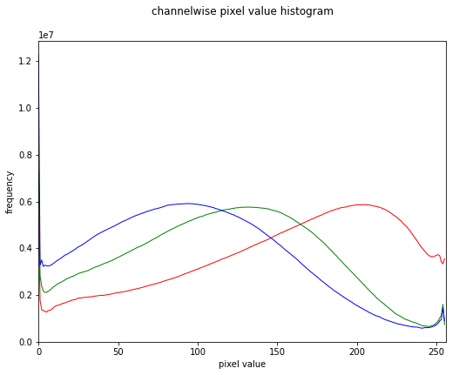
Notes:
Utkface dataset. As you can see we also plotted histogram for channelwise pixel values of R,G and B.
Interestingly, the data seems to have a syymetric distribution

Slide 15
Convolutional Neural Network (CNN)
CNN is a very popular and robust way of dealing with images. It is primarily used for extracting features (higher representations) from the image, which are then fed into a FC layer for classification tasks.
Design 1 -
Input shape - 180 x 180 x 1 (grayscale image)
Conv2D -> Conv2D -> Conv2D -> (Conv2D ) x 3 -> Flatten()-> Dense1 -> (Dense2) x 2 -> Dense3
32, 5x5 64, 5x5 128, 3x3 256, 3x3 128 neurons 64 neurons 1 neuron
Results -
Validation mae - 5.94, validation mse - 60.72 , train mae -2.66 , train mse 13.7
Notes:
Note: Activation function used throughout is ReLU, same padding, stride of one. Dropout of 0.3 was used as regularization in FC layers. BatchNorm was used after each layer.

Slide 16
Design 2
Input shape - 180 x 180 x 3
S.Conv2D -> (S.Conv2D) x 2 -> (S.Conv2D) x 2 -> Flatten() -> Dense1 -> (Dense2) x 2 -> Dense 3
64, 3x3 128, 3x3 256, 3x3 128 neurons 64 neurons 1 neuron
Results -
Validation mae - 5.46 , validation mse - 51.22, train mae - 5.20 , train mse - 46.25
Notes:
Note: Activation function used throughout is ReLU, same padding, stride of one. Dropout of 0.3 was used as regularization in FC layers and Spatial Dropout of 0.15 was used between after each convolutional layer except 1st two. BatchNorm was used after each layer.

Slide 17
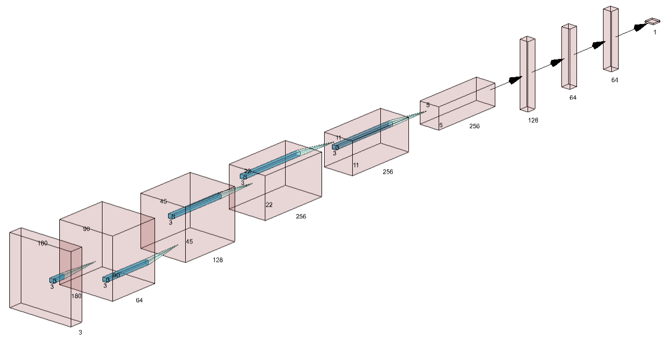

Slide 18
Transfer Learning
VGG16
Custom Model 1
93%
Data | Images
Training | 20,000
Cross-Validation | 1,854
Test | 1,854
ResNet50
Custom
Model 2
95%
VGG16
ResNet50
Custom Model 3
94%
Gender Classification

Slide 19
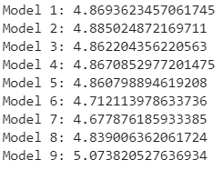
Age prediction as Regression
Train
VGG16 Features Model Prediction
Model Highlights | Results | Benchmarks
3 Conv + 3 FC layers SeparableConv2D SpatialDropout BatchNorms Gaussian Noises Weight Constraints Dropout |  | Various Papers 9.19* 7.36 (Git Repo) 5.44 (MobileNet) 5.39 (CORAL)
* Proceedings of International Joint Conference on Computational Intelligence - Oct-2019

Slide 20
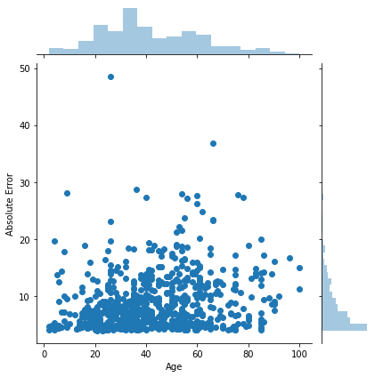
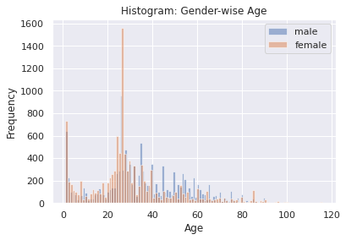
Error Analysis
Bad | Good
Low Resolution / Unreal Blacks Very Old Wrong Labels | High Resolution Others 50 or younger

Slide 21
DL > ML ?
Model | Test
Neural Networks ( Tuned ) | 0.9395
SVC | 0.9363538296
LDA | 0.9363538296
Voting Classifier - Top3 | 0.9336569579
QDA | 0.9314994606
Stochastic GBoost | 0.9309600863
XGBoost | 0.9282632147
Bagging | 0.9234088457
AdaBoost | 0.9234088457
Gradient Boosted Trees | 0.9207119741
Random Forest | 0.9196332255
LogisticRegression | 0.9190938511
Perceptron | 0.9190938511
Voting Classifier | 0.9174757282
SGDClassifier - Linear SVM | 0.9099244876
KNeighborsClassifier | 0.9088457389
SGDClassifier - Logreg | 0.9034519957
Linear SVC | 0.8948220065
DecisionTreeClassifier | 0.8759439051
Data and Scalability
Computation Power
Challenge - Hyperparameter Tuning
Grid Search vs Random Search
Data, Assumptions
Resources
Problem
Application
Time Constraint - like this.

Slide 22
SVM model
The improved model consisted of this basic pipeline of workflow :-
General EDA
Pre-processing techniques
Face detection and further augmentation
Feature engineering
Dimensionality reduction
Applying SVM and accuracy analysis

Slide 23
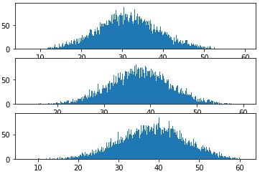
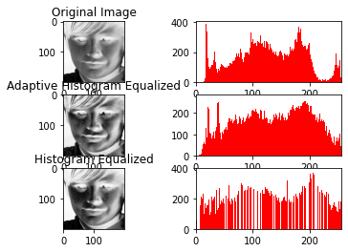
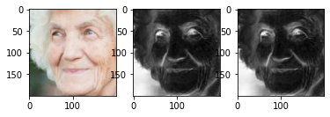
Pre-processing methods

Slide 24
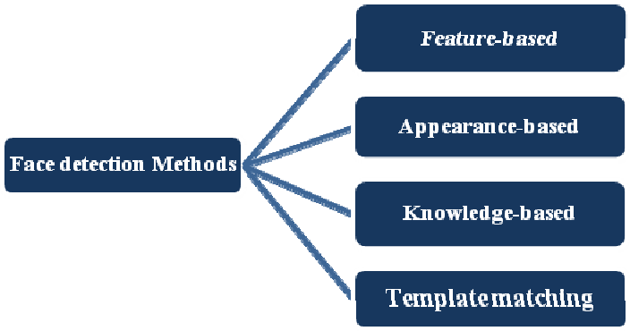
a) Face detection & augmentation
Viola jones method
Harr like features
Integral Image
Adaboost Cascade
HOG filter was also considered
Eyes were detected and thus by the angle we get to know if the face is straight. It was then shifted, scaled and straightened.

Slide 25
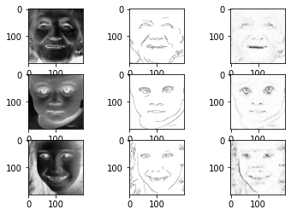
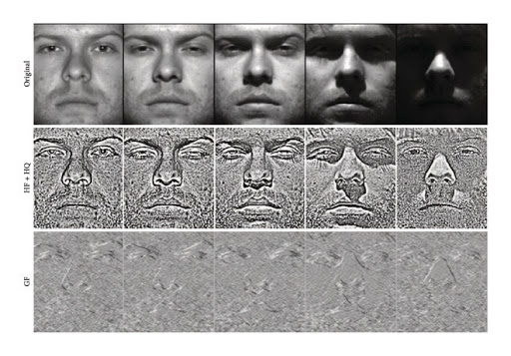
b) Feature engineering

Slide 26
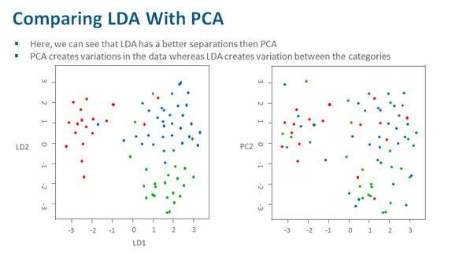
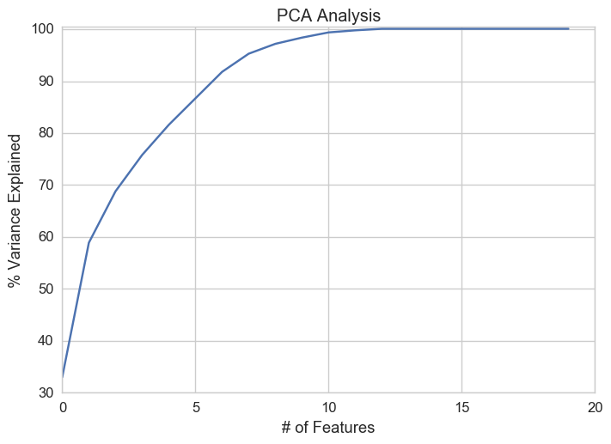
Dimensionality reduction

Slide 27
SVM Model Analysis
SVM model used 5 fold CV and used these additional accuracy improvements :
Voting classifier using Poly and rbf kernel
Adaboost SVM
Random Forest - SVM (only for age)
KNN(classification) - SVM(regression)
Further these will be tuned using Grid search, Random search and Bayesian Optimization.
Result - 93.5% test accuracy for voting classifier

Slide 28


Slide 29
What next ????
Research paper
Different methods and their results.
Model Benchmarking
Practical implementation
Using 3-D image analysis
Image enhancement and face detection in real video stream.
Application domain
Embedding with IoT and making a real life solution.
Smart Cosmetic solutions

Slide 30


